Slide 1
Lecture 18 – Discrepancies, Anomalies, Mishaps and Root Cause Analysis

Slide 2
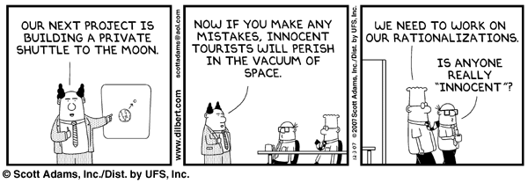

Slide 3
When things go wrong…..
Close Calls – a near miss – a condition that could have caused a discrepancy, anomaly or mishap but was caught before it occurred
Discrepancy – a problem discovered during manufacturing or testing
Anomaly – a problem discovered during operations
Mishap – a problem that causes injury, death or loss of major equipment

Slide 4
What is a problem ?
A violation of requirements
  An out of specification condition
  Failure to meet test or inspection requirements
Failure to conform to drawings (“out of print”)
Failure to meet end to end function
Meets requirements but requirements are incorrect

Slide 5
Problem Resolution for Discrepancies
One time acceptance – “use as is” based on analysis of the specific defect or condition
  May impose operating limitations
  Operating limitations are normally called placards
Reject – dispose of component
Rework to “return to print”
Change to requirements to make the item acceptable

Slide 6
NASA Mishap Classification
Type A Mishap. A mishap resulting in one or more of the following: (1) an occupational injury or illness resulting in a fatality, a permanent total disability, or the hospitalization for inpatient care of 3 or more people within 30 workdays of the mishap; (2) a total direct cost of mission failure and property damage of $1 million or more; (3) a crewed aircraft hull loss; (4) an occurrence of an unexpected aircraft departure from controlled flight (except high performance jet/test aircraft such as F-15, F-16, F/A-18, T-38, OV-10, and T-34, when engaged in flight test activities).
Type B Mishap. A mishap that caused an occupational injury or illness that resulted in a permanent partial disability, the hospitalization for inpatient care of 1-2 people within 30 workdays of the mishap, or a total direct cost of mission failure and property damage of at least $250,000 but less than $1,000,000.
Type C Mishap. A mishap resulting in a nonfatal occupational injury or illness that caused any days away from work, restricted duty, or transfer to another job beyond the day or shift on which it occurred, or a total direct cost of mission failure and property damage of at least $25,000 but less than $250,000.
Type D Mishap. A mishap that caused any nonfatal OSHA recordable occupational injury and/or illness that does not meet the definition of a Type C mishap, or a total direct cost of mission failure and property damage of at least $1,000 but less than $25,000.
Source – NPR 8621.1B

Slide 7
Mishap Initial Response
Do whatever is necessary to protect lives and valuable assets. Do not begin mishap procedures until this si complete.
Safe the Mishap site and initiate your mishap response plan
  Have to build a response plan ahead of time
  Best in a checklist format for the first few hours
Notify senior management
Deploy Incident Response Team – pre-identified
Notify personnel and public of potential hazards
Secure the site and preserve evidence
Impound data
Initiate drug testing (in fatality, personal injury or high value asset) per appropriate human relations/legal policies
Collect witness statements
Coordinate release of information
Notify Occupational Safety and Health Administration (within 8 hours)
Record the mishap

Slide 8
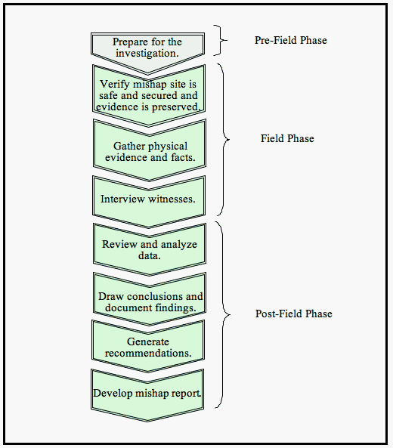
Mishap Investigation – usually performed by independent board

Slide 9
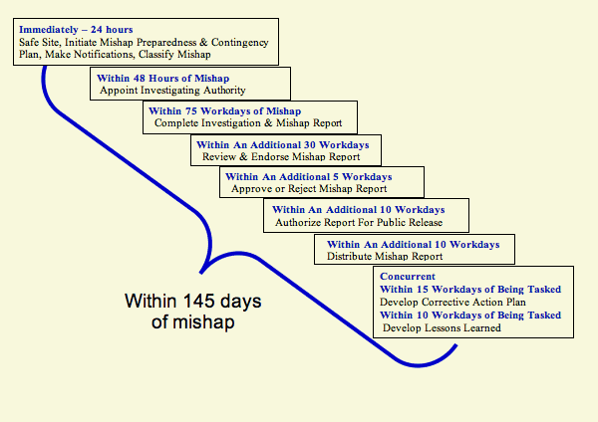
Notes:
This is from NASA guidance on mishap response planning

Slide 10
Root Cause Analysis
When investigating a discrepancy, anomaly or mishap, the immediate cause may not be the root cause
For example – consider a car that won’t start and you find that the battery is dead
  It could be a battery beyond its life
  It could be equipment left powered on
  It could be another electrical drain in the system
  It could be an alternator failing to charge
If the battery is beyond its life, simply replacing it will solve the problem
If the problem is one of the other root causes, the battery will rapidly drain again and you’ll have another failure

Slide 11
To find root cause..
Play the toddler’s game
  Just keep asking “why ?”

Slide 12
Causes and Corrective Action
Proximate Cause. The event(s) that occurred, including any condition(s) that existed immediately before the undesired outcome, directly resulted in its occurrence and, if eliminated or
modified, would have prevented the undesired outcome. Also known as the direct cause(s).
Contributing Factor. An event or condition that may have contributed to the occurrence of an undesired outcome but, if eliminated or modified, would not by itself have prevented the
occurrence.
Corrective Actions. Changes to design processes, work instructions, workmanship practices, training, inspections, tests,

Slide 13
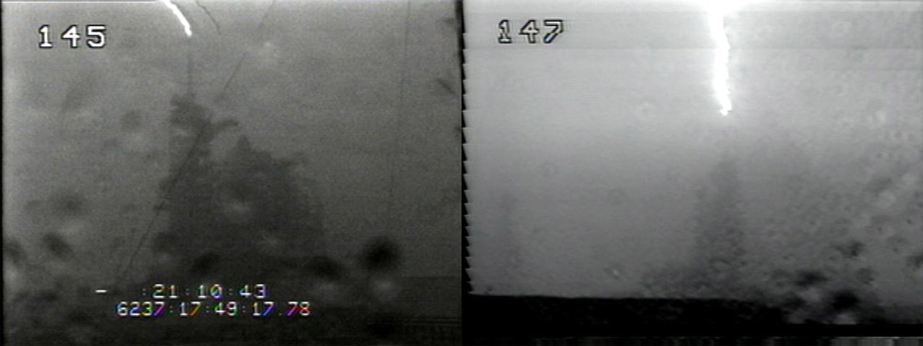
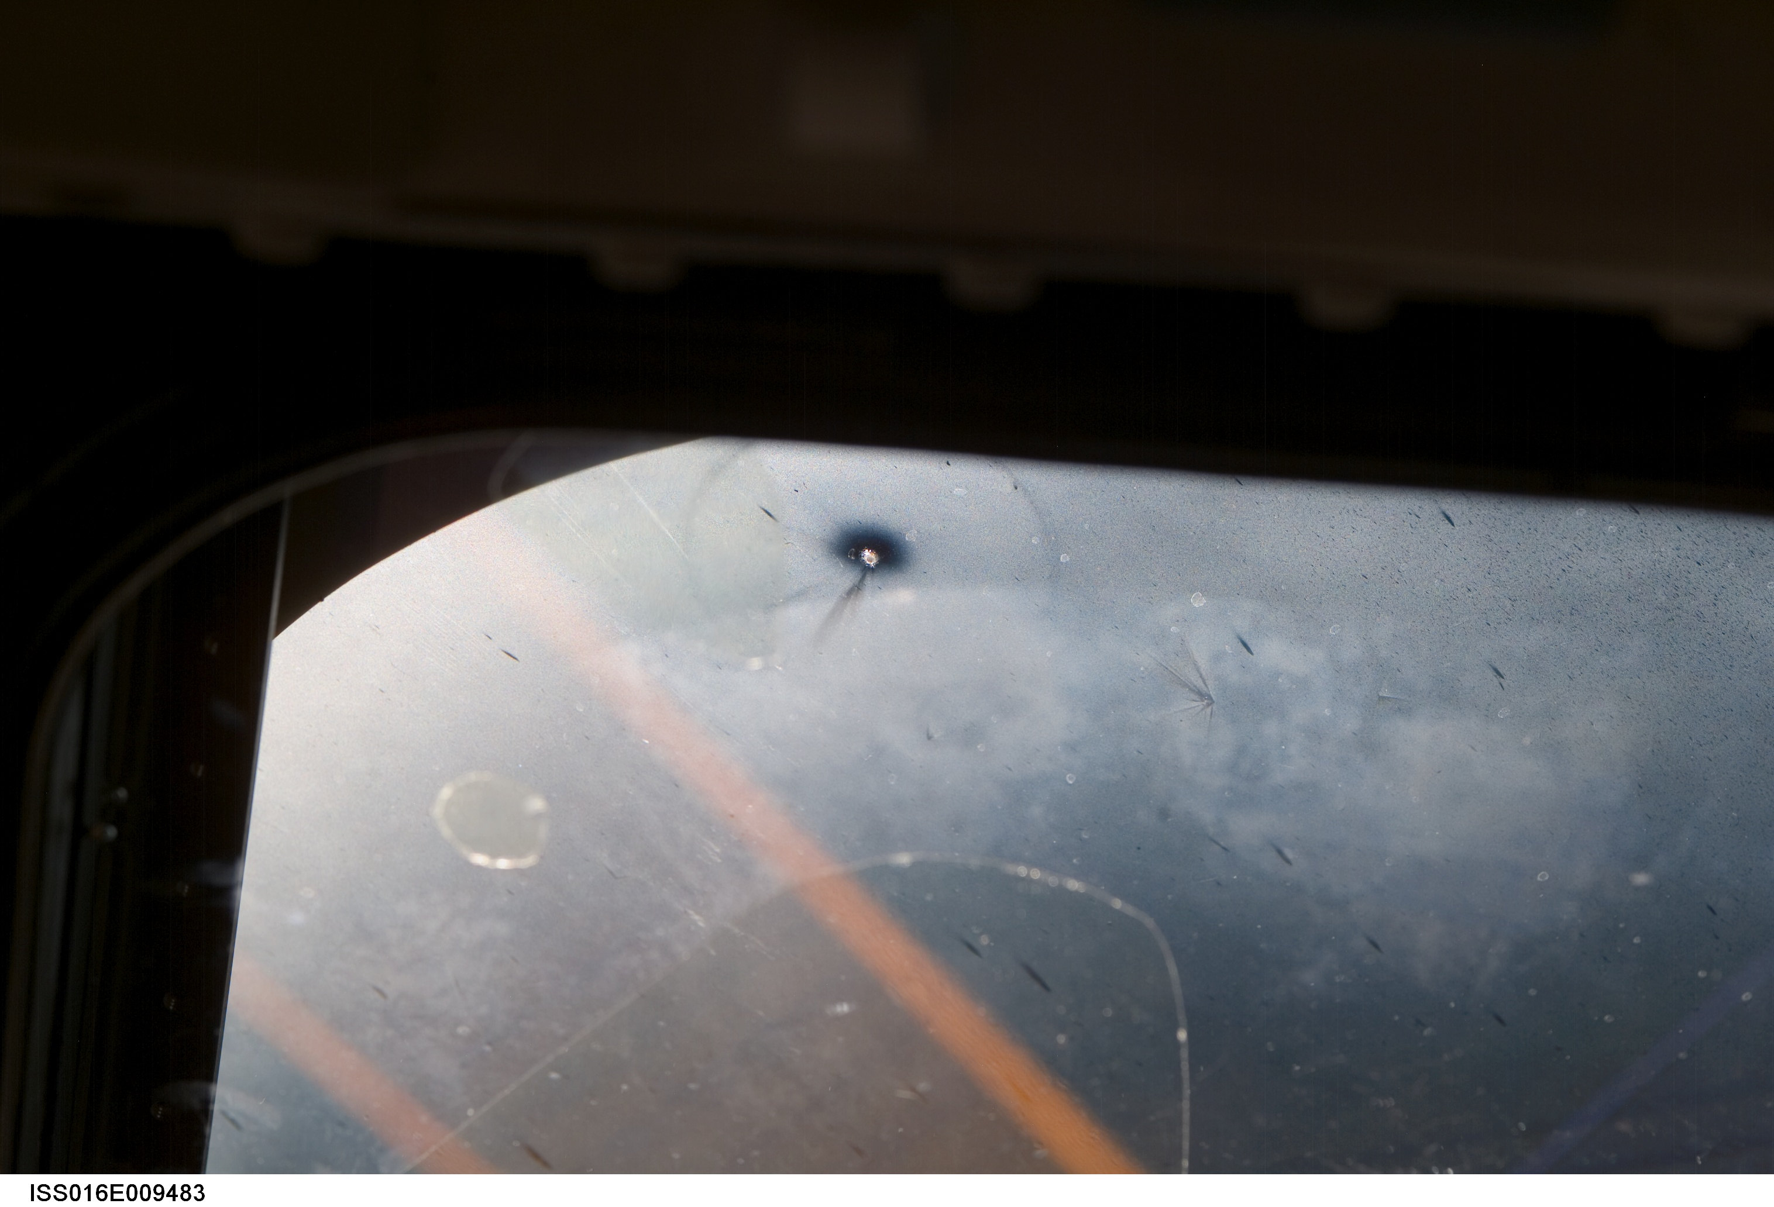
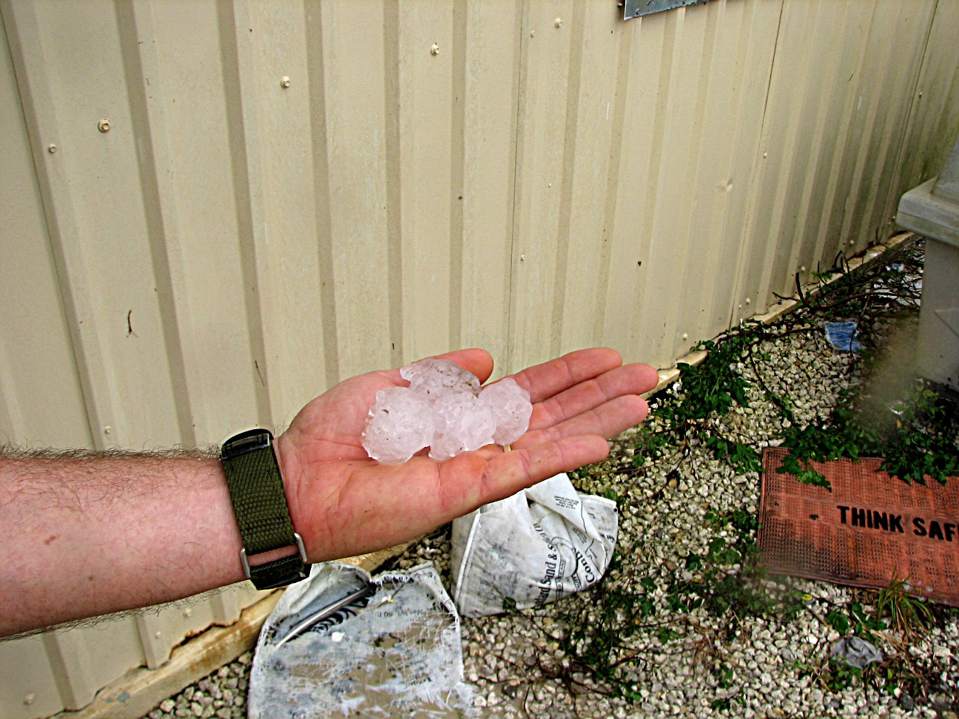
Lightning Strike
Natural Disasters
Hail Damage
Micrometeoroid Impact

Slide 14
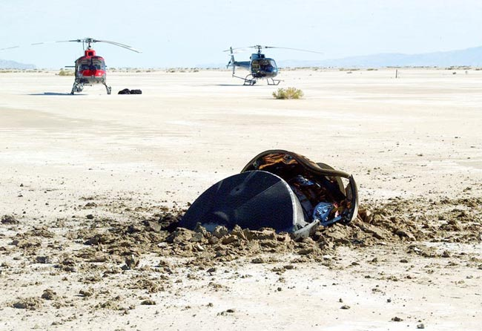
Genesis Probe
G switch installed upside down (not per drawing)
G switch not tested
Spacecraft failed to sense deceleration as the spacecraft entered thicker atmosphere so it never deployed the parachute

Slide 15
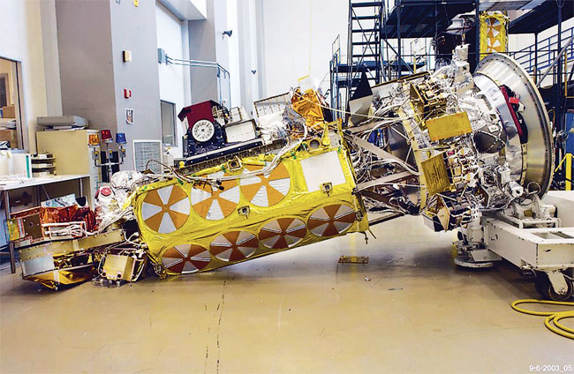
Tiros-N
Multi-use Ground Support Equipment (GSE) used to manipulate spacecraft to different attitudes during test
For this spacecraft, the GSE required insertion of certain retaining pins
These were not required by the previous test
GSE out of configuration (procedural error) leads to tip over

Slide 16
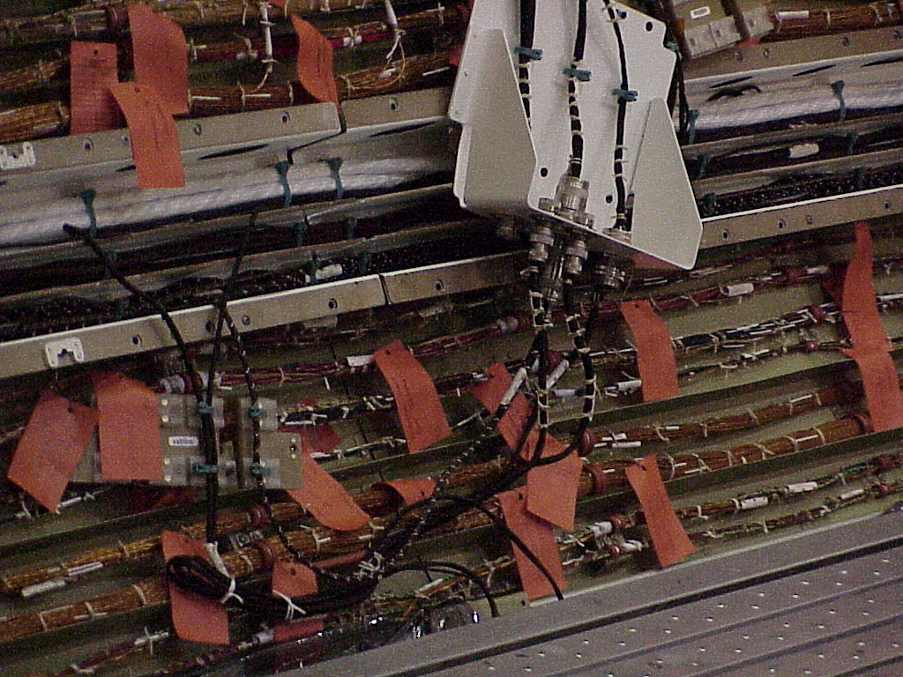
Orbiter Wiring
During STS-93 a short in orbiter AC bus causes system malfunctions
Short later traced in insulation rubbed away on structural fastener
Subsequent inspection showed thousands of discrepancies in wiring system
  Some due to vibration
  Some due to damage during ground operations
  Some due to original installation error
Wire needed to be properly protected

Slide 17
Lessons Learned
It is well worth the time to seek out lessons from the past and to examine current activities to see if the same issue could repeat itself
“Those who cannot learn from history are doomed to repeat it ” George Santayana
In reviewing lessons learned
  Read first for the specifics – does it apply to you ?
  Then generalize the situation (go up one level of abstraction) and see if it has applicability for you
Re-review lessons learned as they carry different messages when you have different experience
Databases without engagement are worthless

